Slide 1

GETTING TO KNOW EACH OTHER

Slide 2

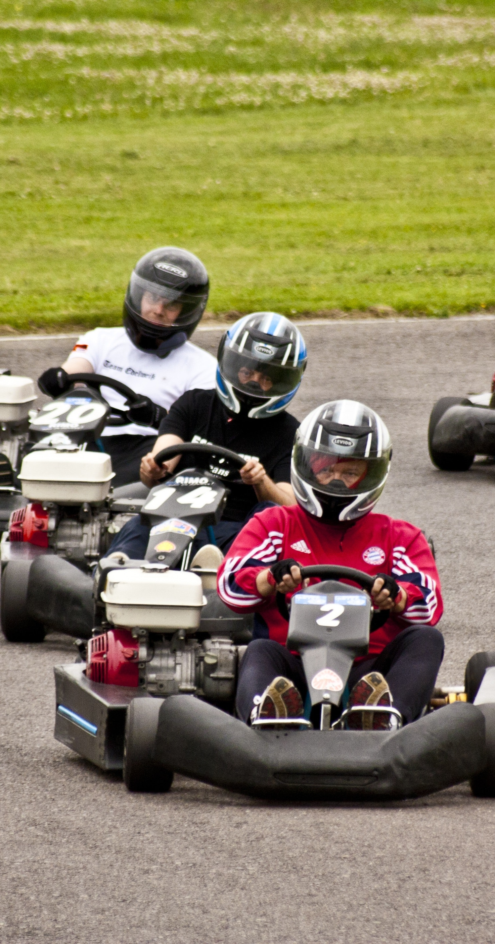
LASER TAG
TEST RUN
GO KARTS
RULES
LOCATE AREA 1 AND AREA 2.
THE PICTURE ON THE LEFT WILL REPRESENT AREA 1 AND THE PICTURE ON THE RIGHT WILL REPRESENT AREA 2.
ON THE INSTRUCTOR'S DIRECTIVE GO TO THE RESPECTIVE AREA BASED ON THE CONCEPT YOU PREFER THE MOST (YOU CAN ONLY CHOOSE ONE).
YOU HAVE 5 SECONDS TO GET TO EACH AREA WHEN THE SLIDE CHANGES.

Slide 3


SOCIAL STUDIES
ENGLISH

Slide 4


SCIENCE
MATH

Slide 5


ANDROID
APPLE

Slide 6
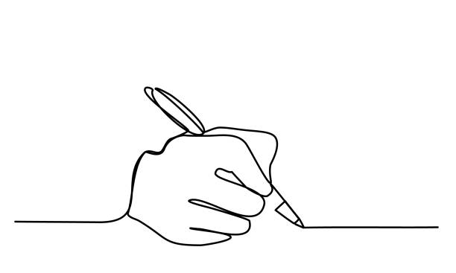

TYPE
WRITE

Slide 7


TEXT
CALL

Slide 8


INSTAGRAM
TIK TOK

Slide 9


TUBI
HULU

Slide 10
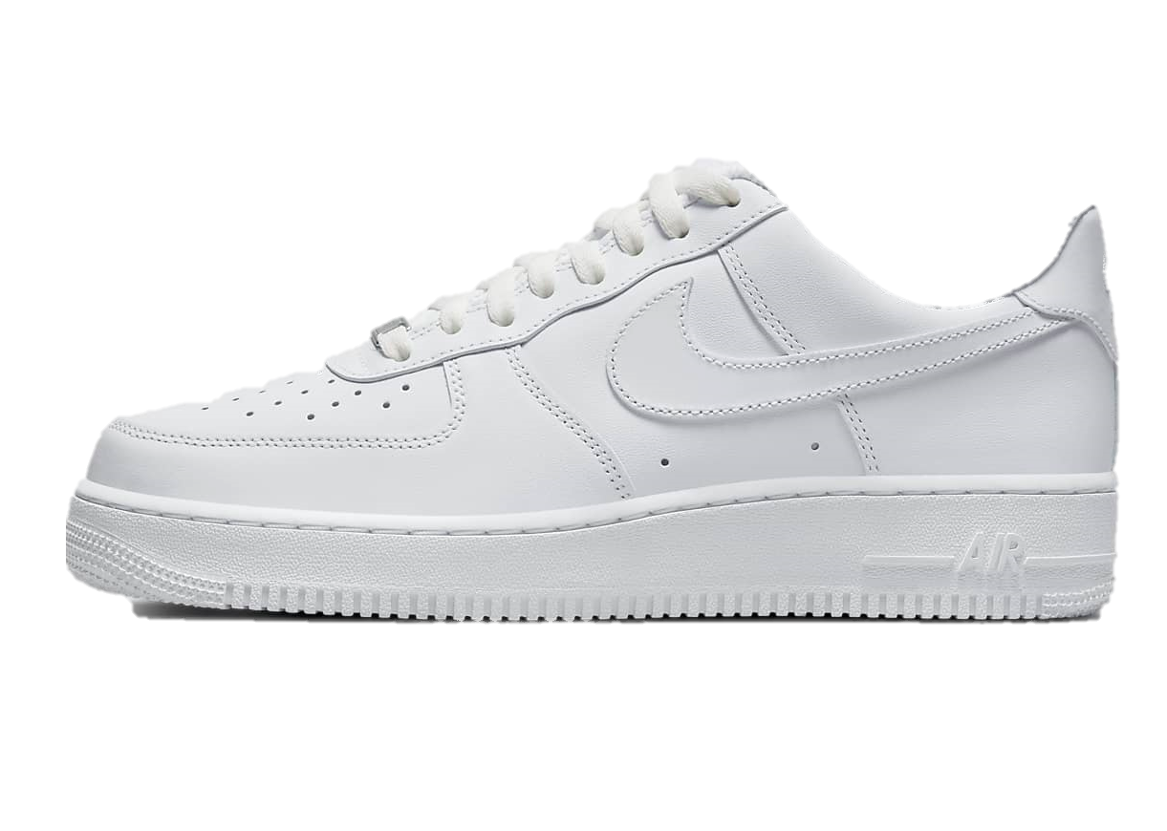
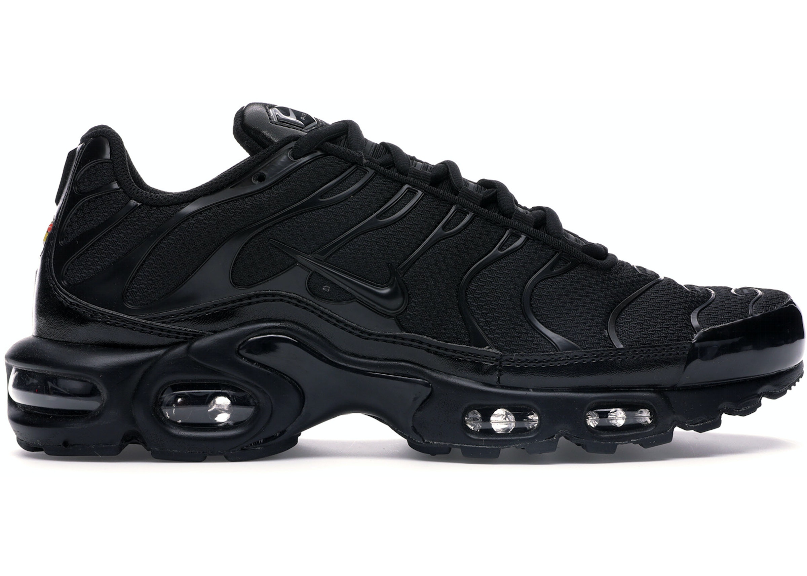
AIR FORCES ONES
AIR MAX (ANY)

Slide 11


BASKETBALL
FOOTBALL

Slide 12
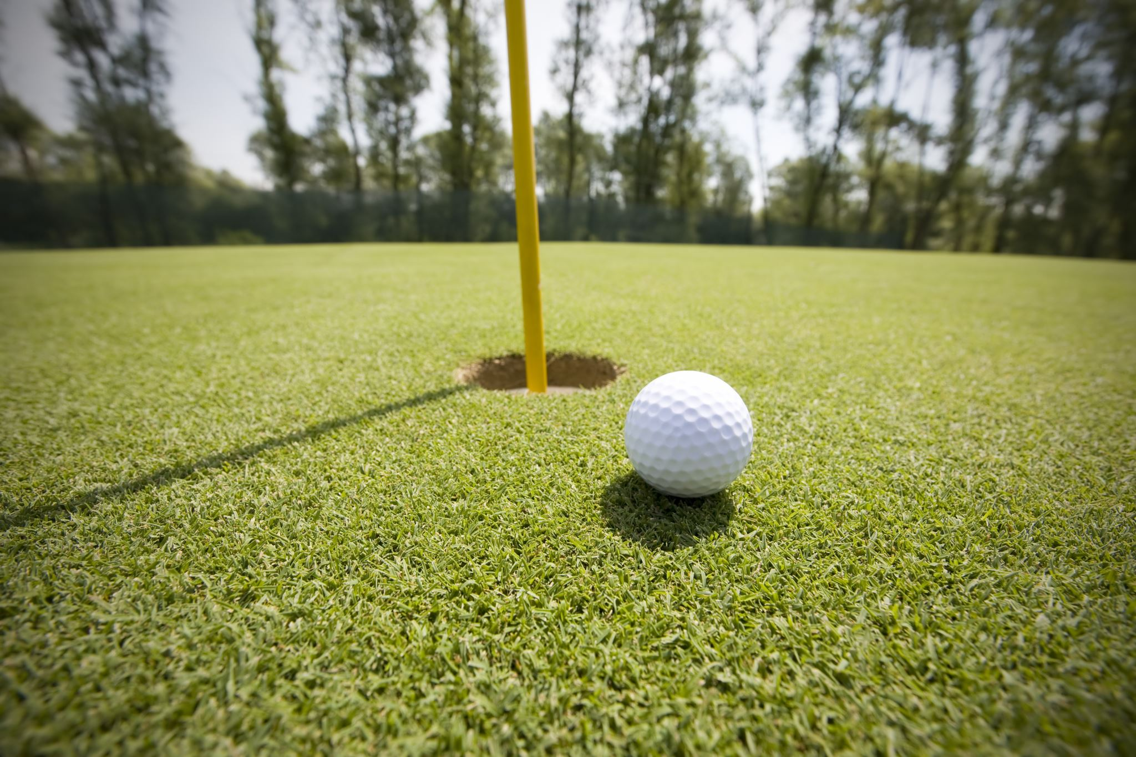
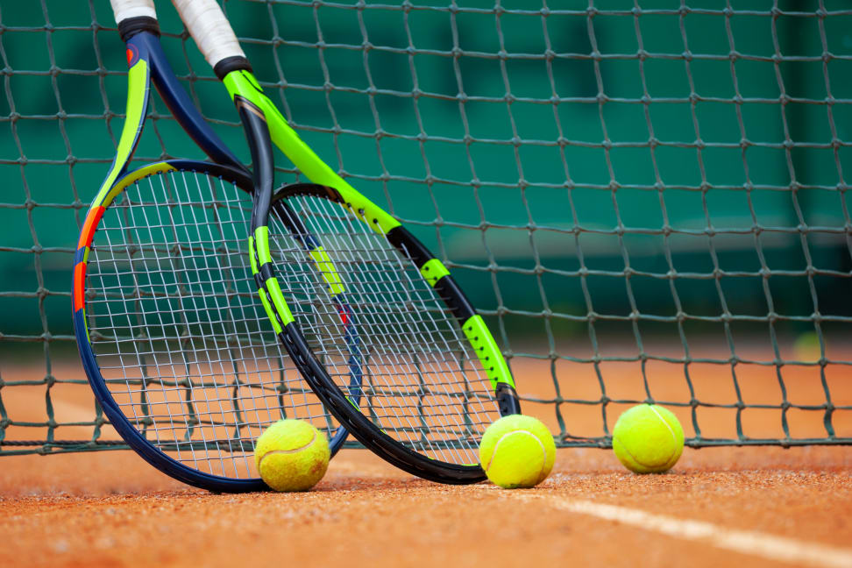
GOLF
TENNIS

Slide 13


SOCCER
VOLLEYBALL

Slide 14
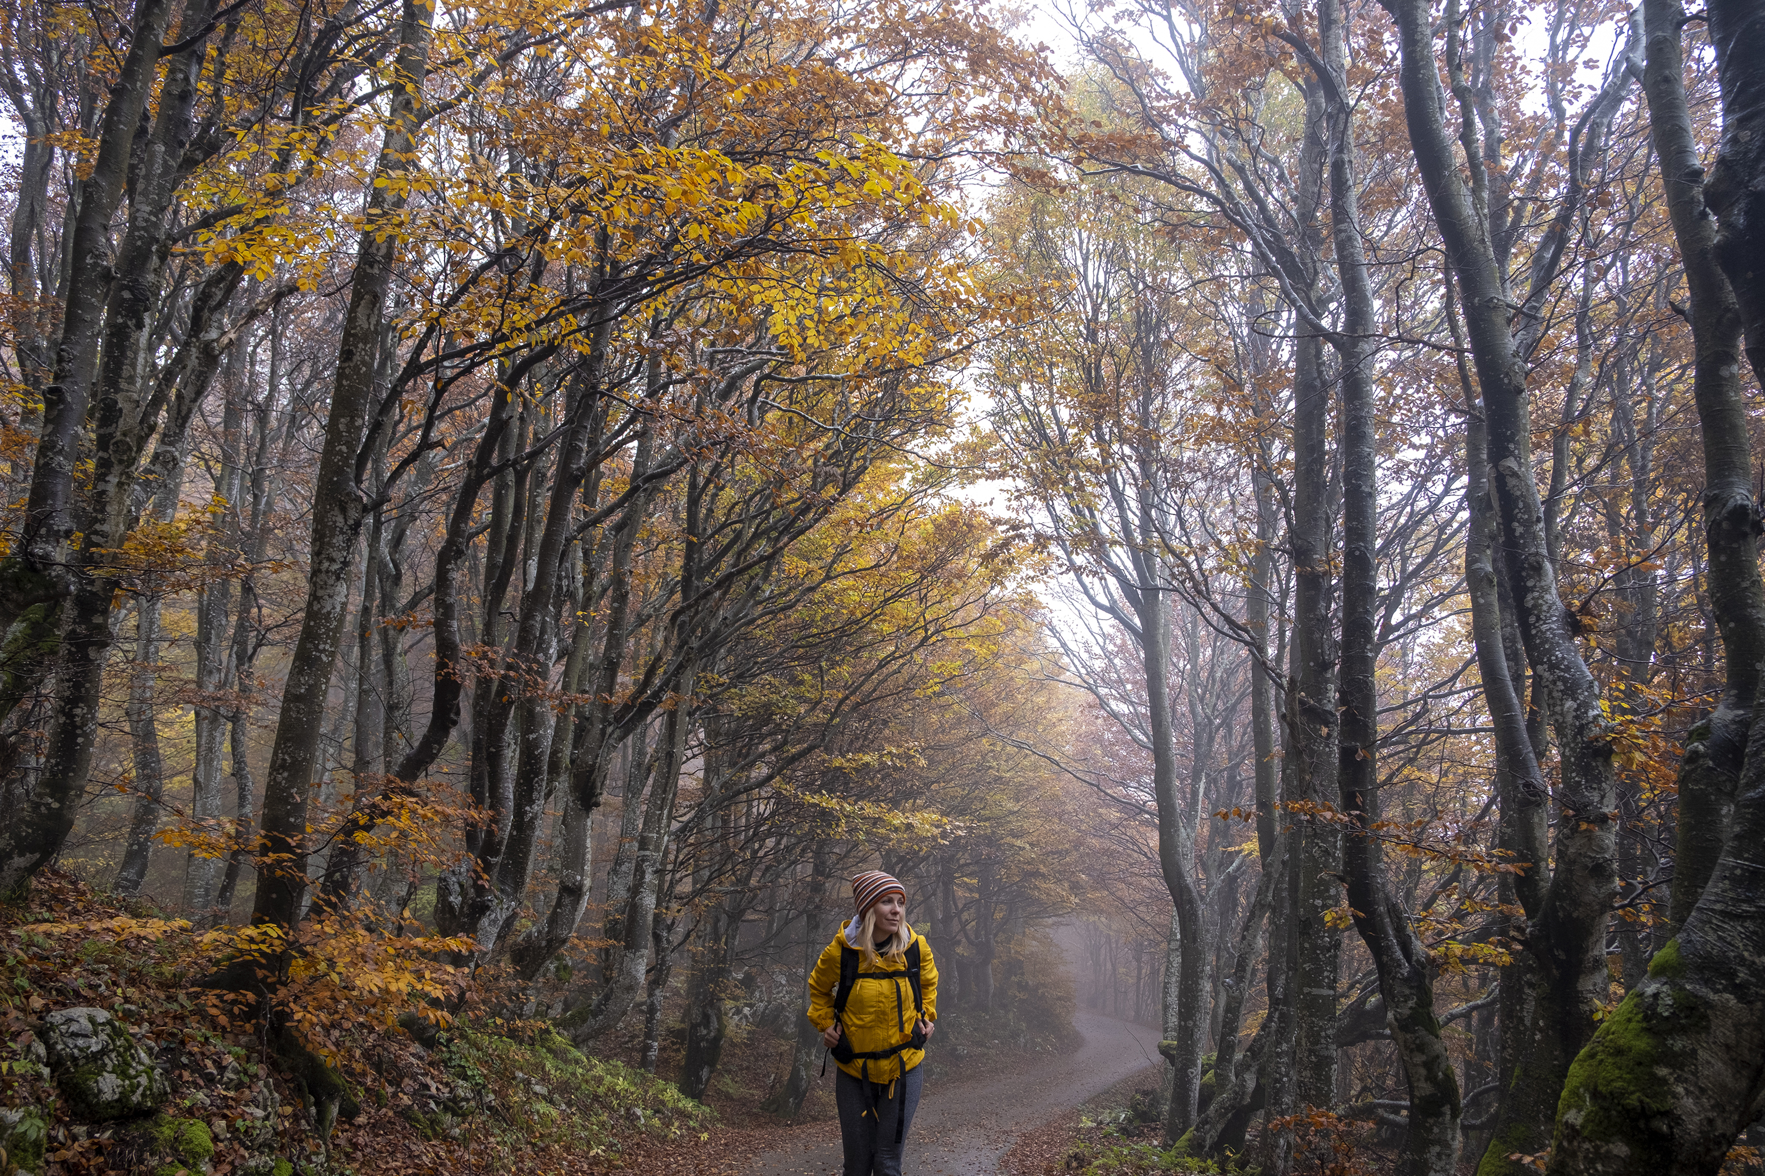

OUTDOORS
INDOORS

Slide 15
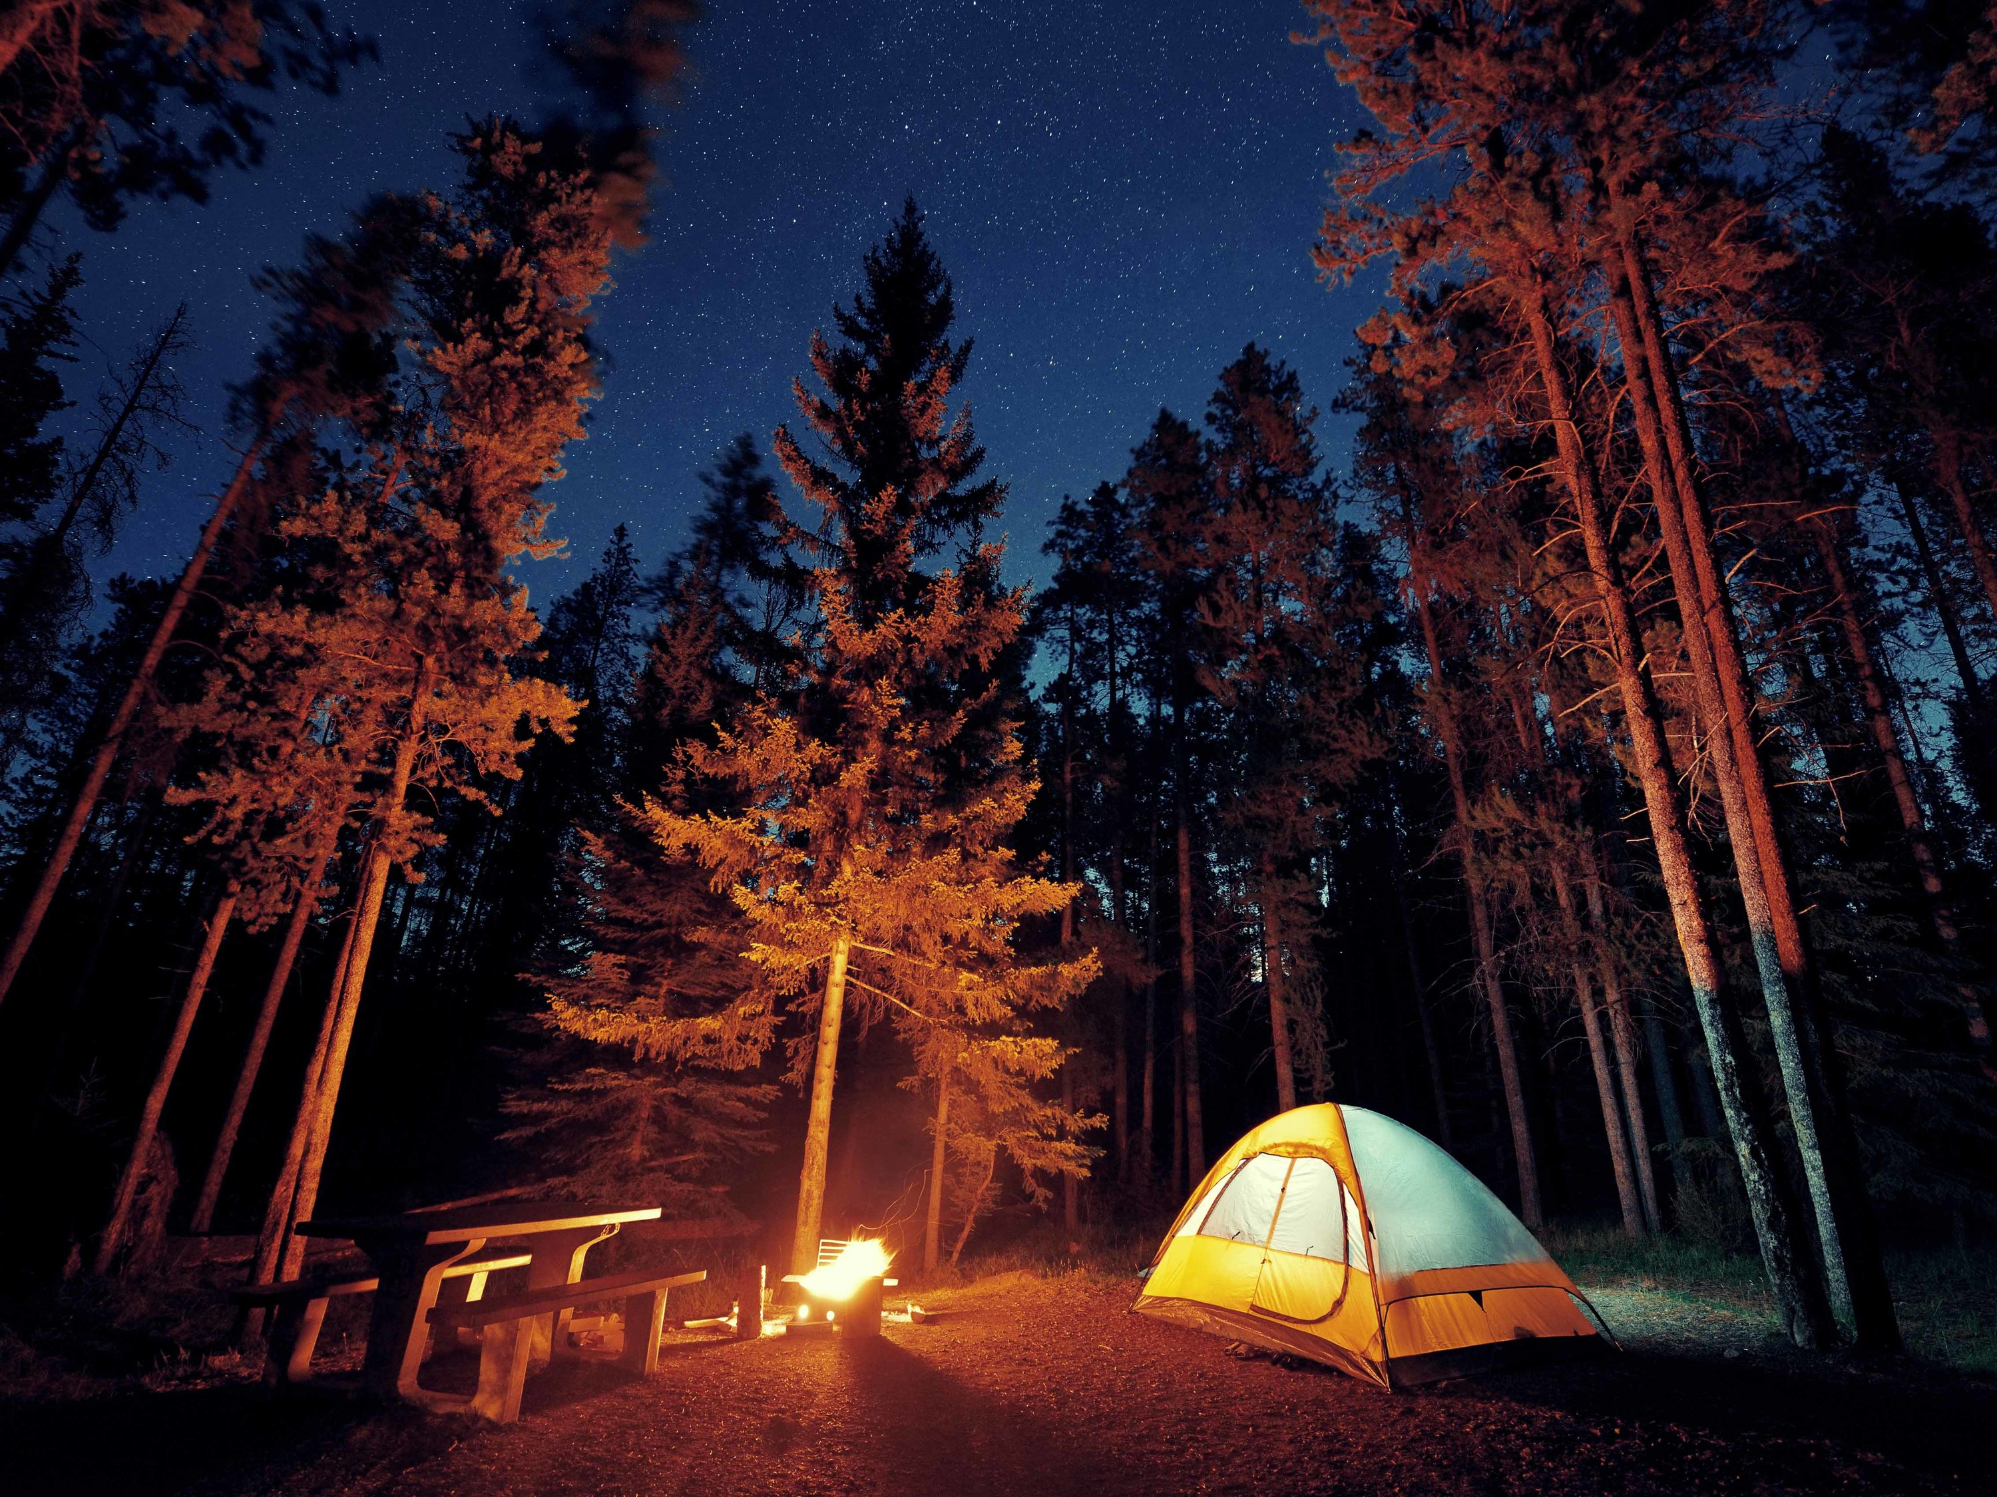
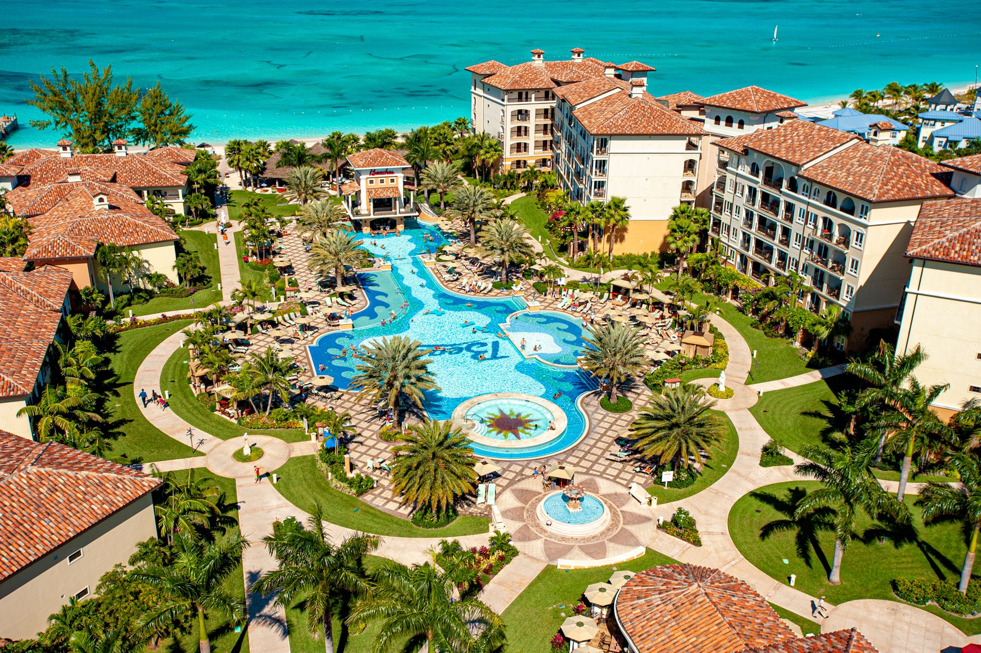
CAMPING
RESORT

Slide 16


POOL
BEACH

Slide 17


SWIMMING
LIFT WEIGHTS

Slide 18
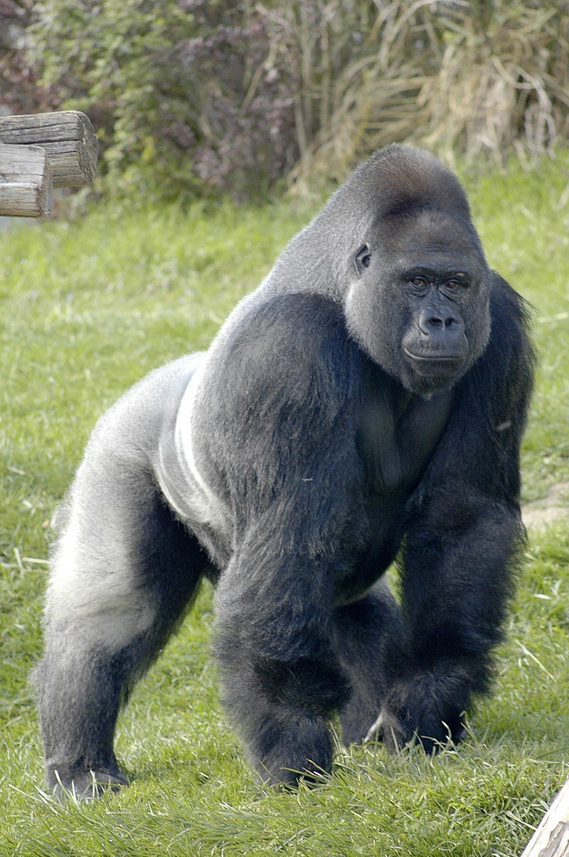

LION
GORRILA

Slide 19
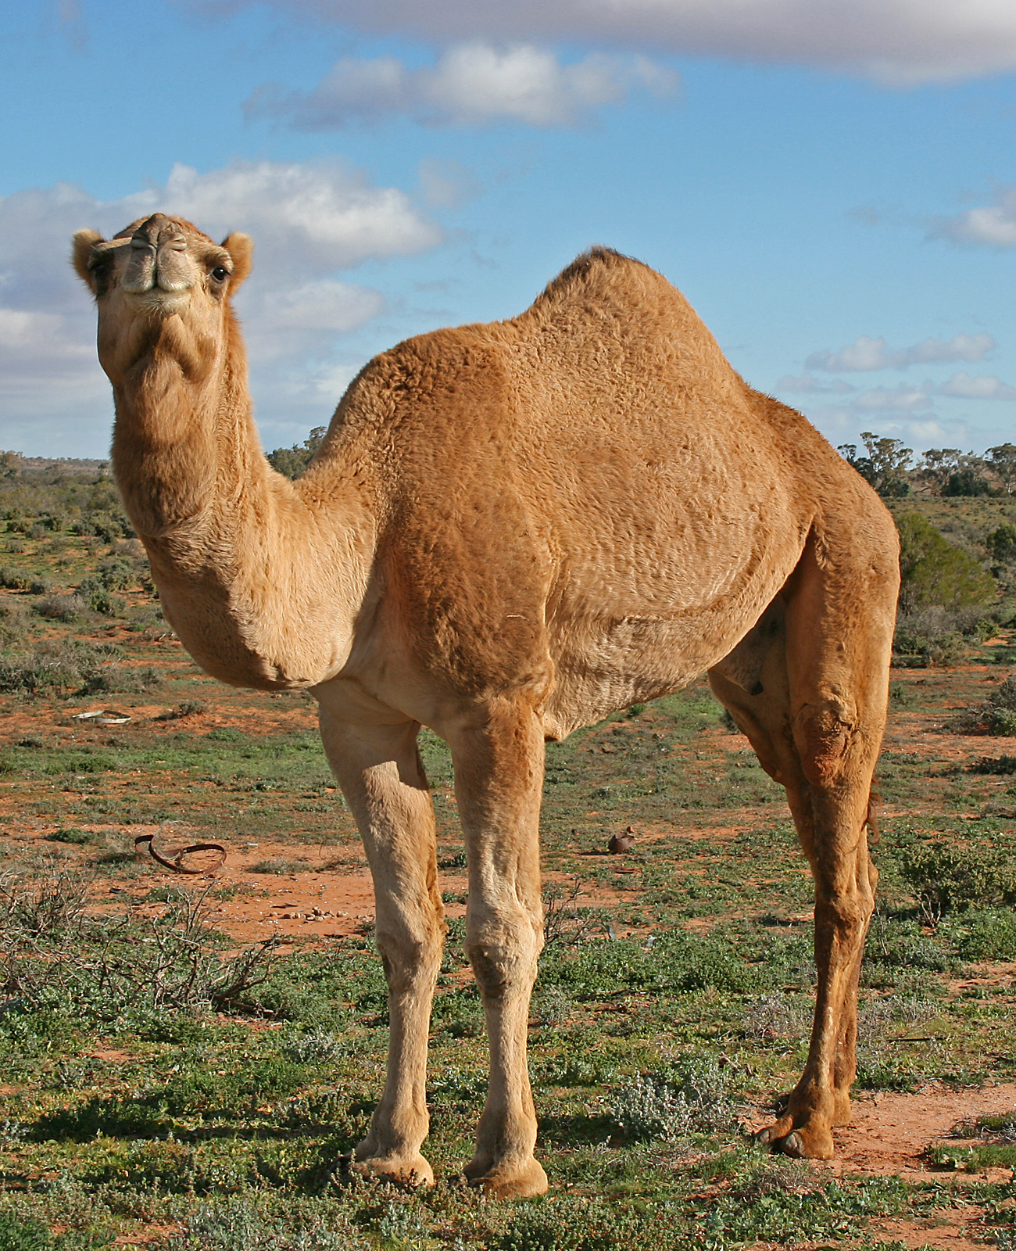
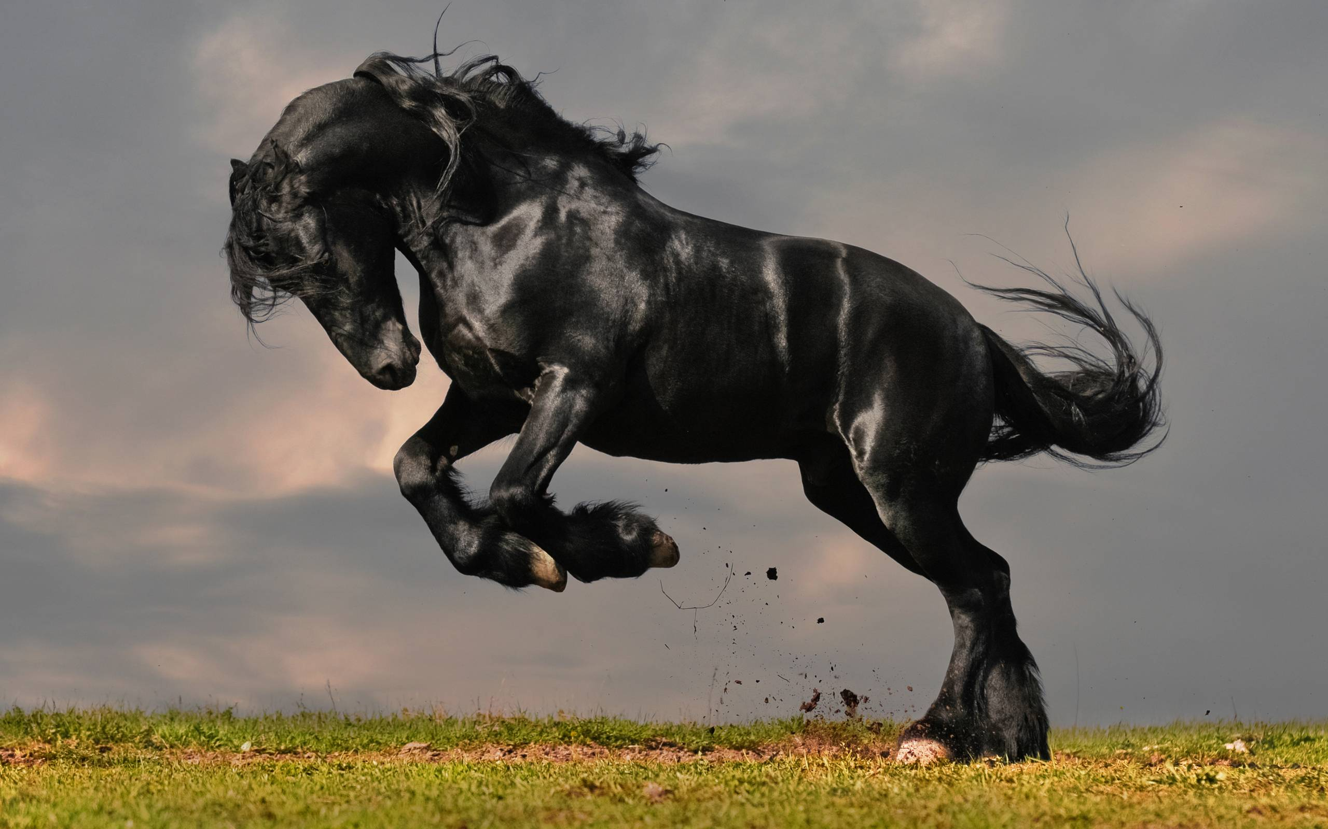
HORSE
CAMEL

Slide 20
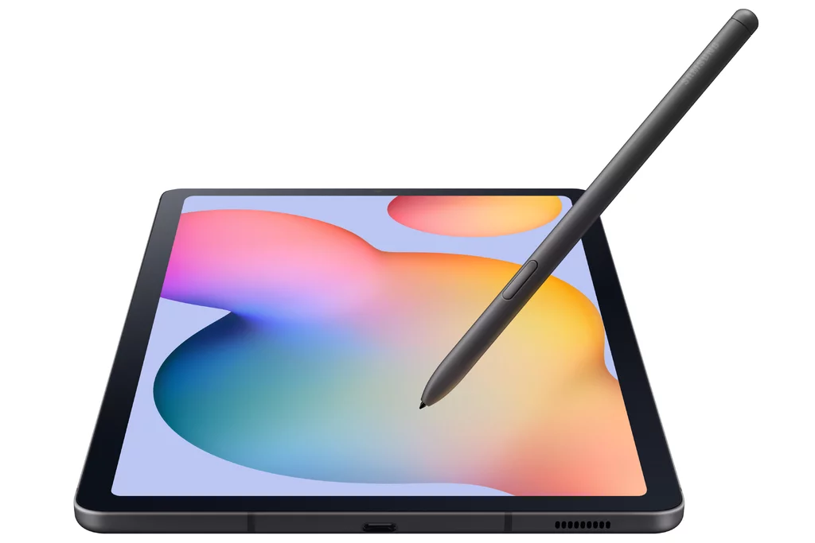

LAPTOP
TABLET

Slide 21


PLAYSTATION
XBOX

Slide 22


MADDEN
SUPER MARIO

Slide 23
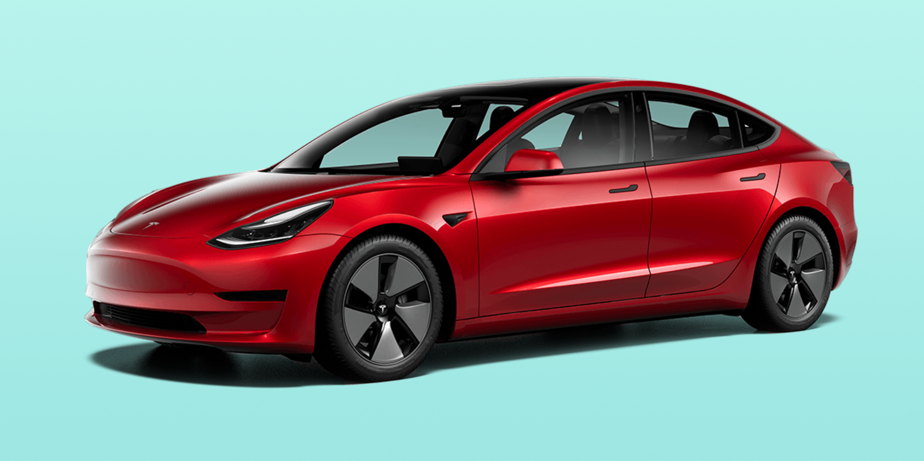
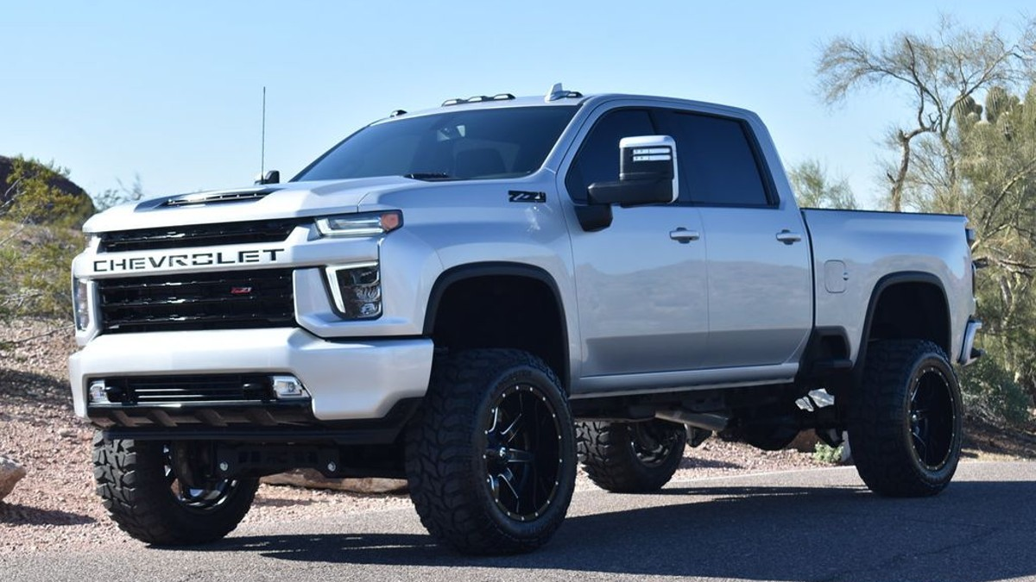
ELECTRIC CAR
DISEL TRUCK

Slide 24


VH1
MTV

Slide 25
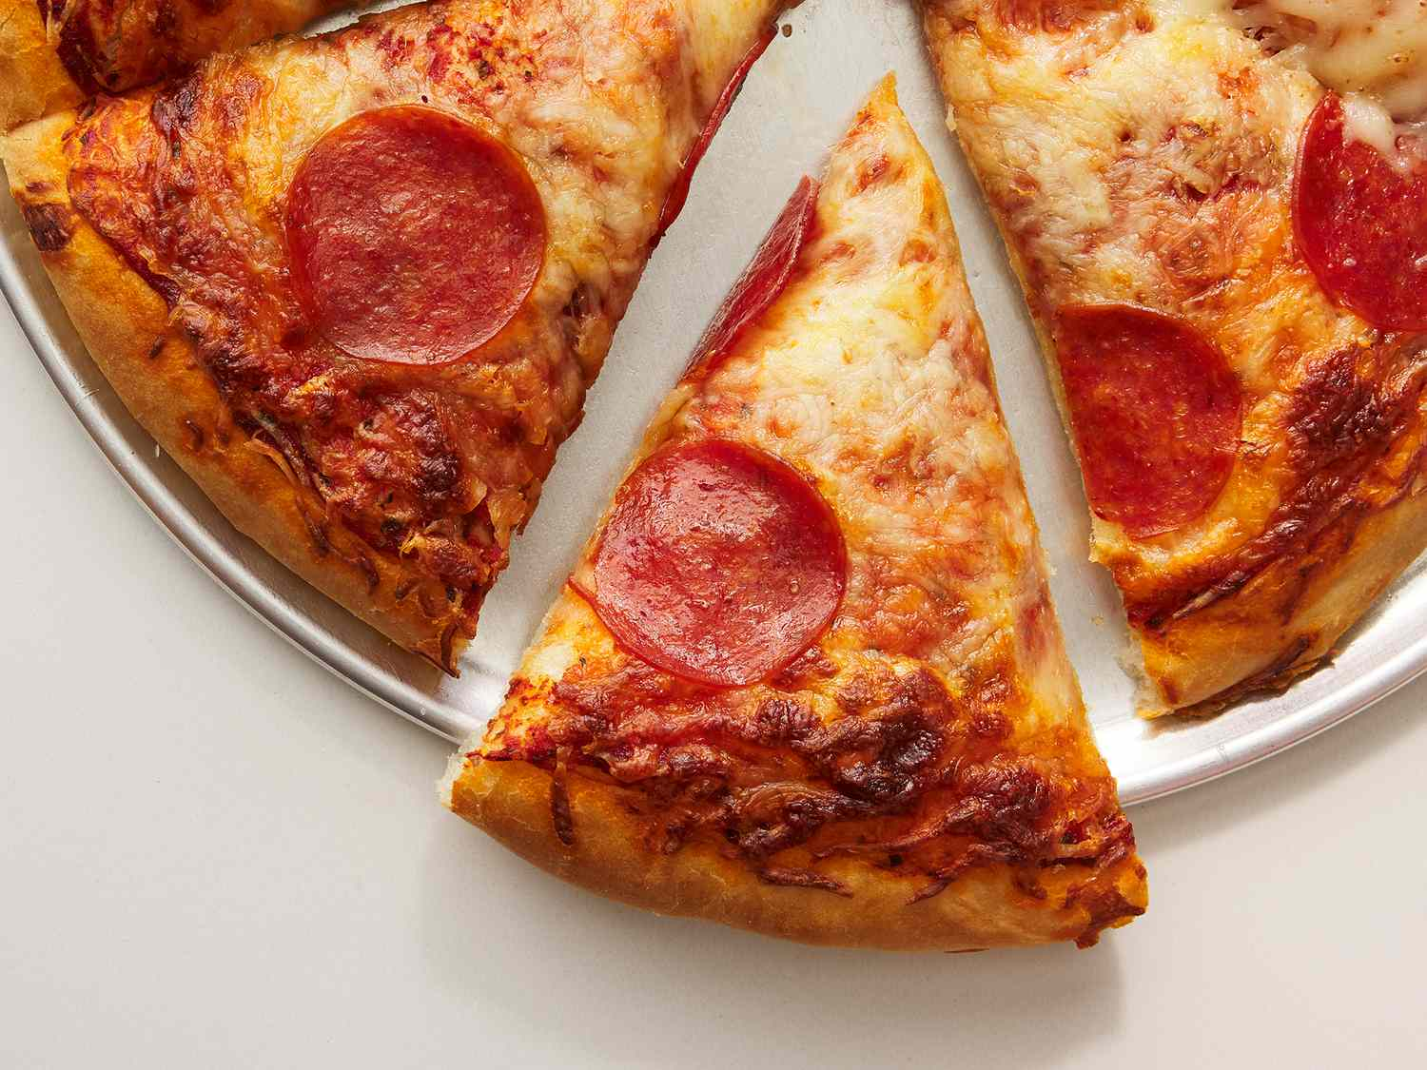
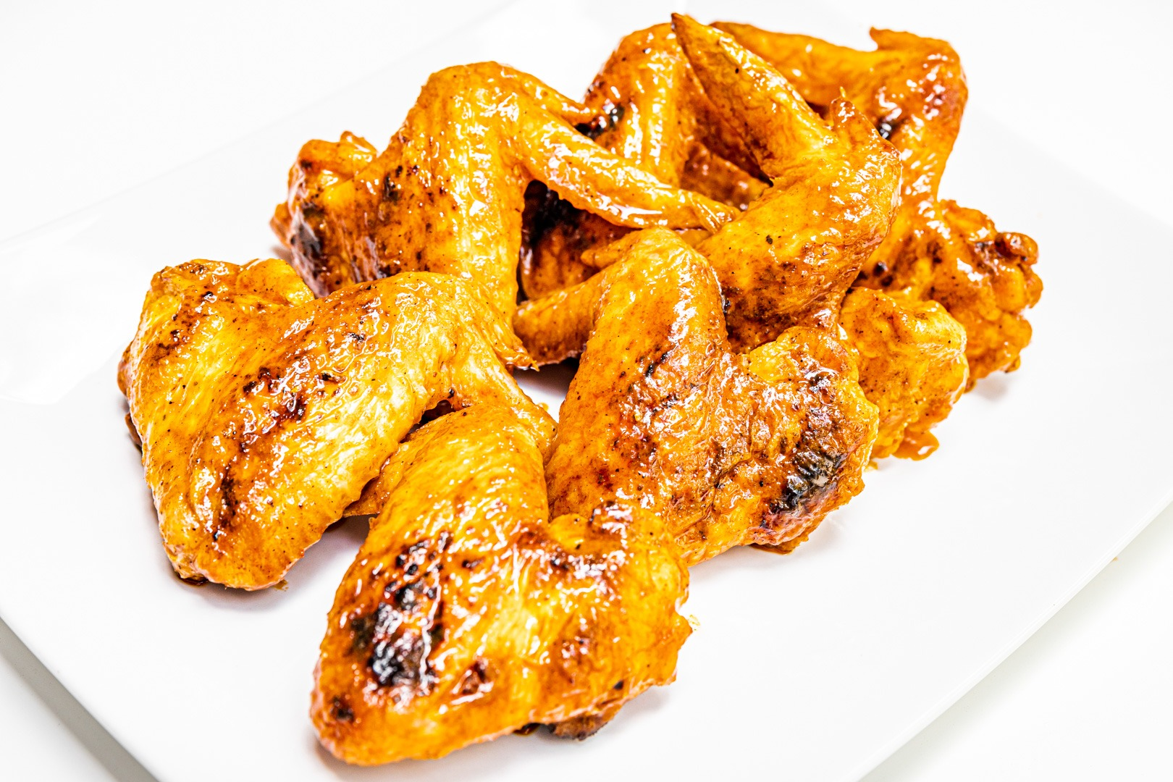
PIZZA
WINGS

Slide 26
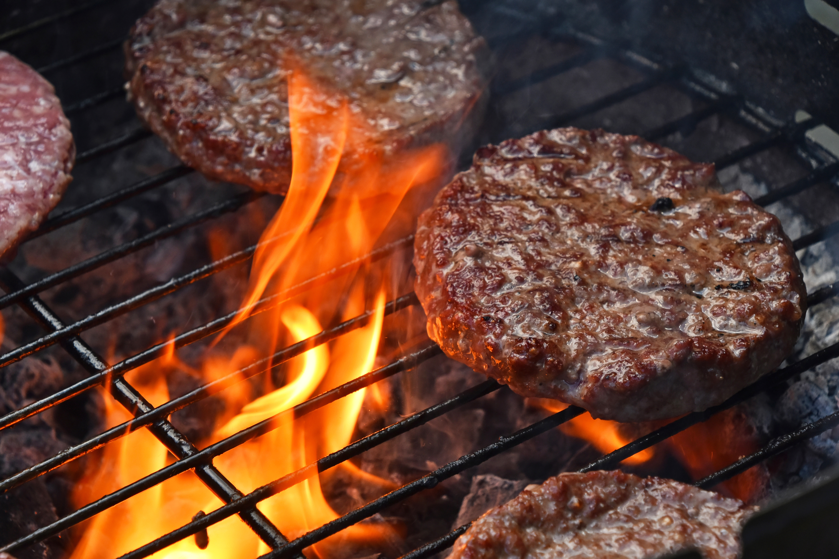
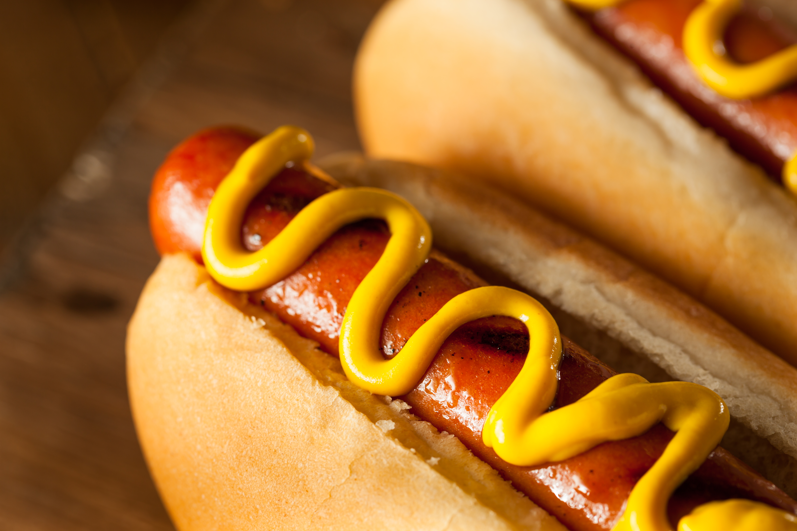
HAMBURGER
HOT DOG

Slide 27


MCDONALD'S
BURGER KING

Slide 28


SUBWAY
FIREHOUSE SUBS

Slide 29


SMOOTHIE KING
TROPICAL SMOOTHIE

Slide 30
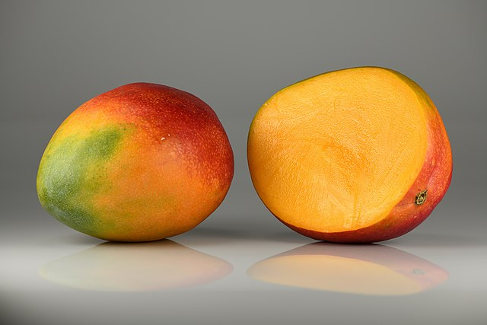

MANGO
WATERMELON

Slide 31
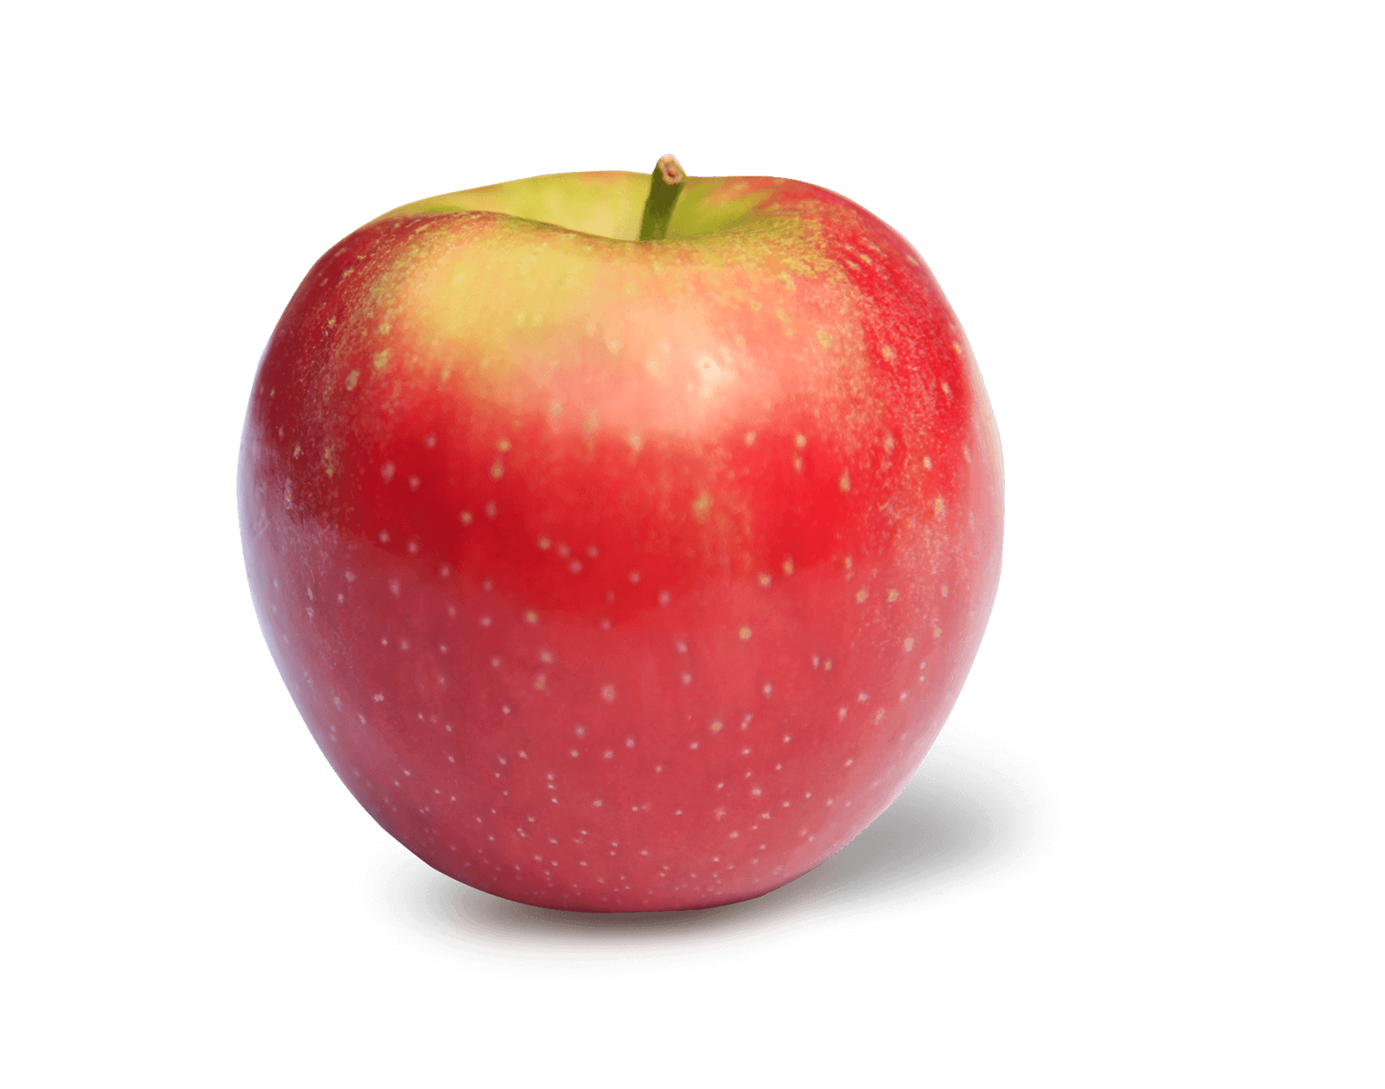
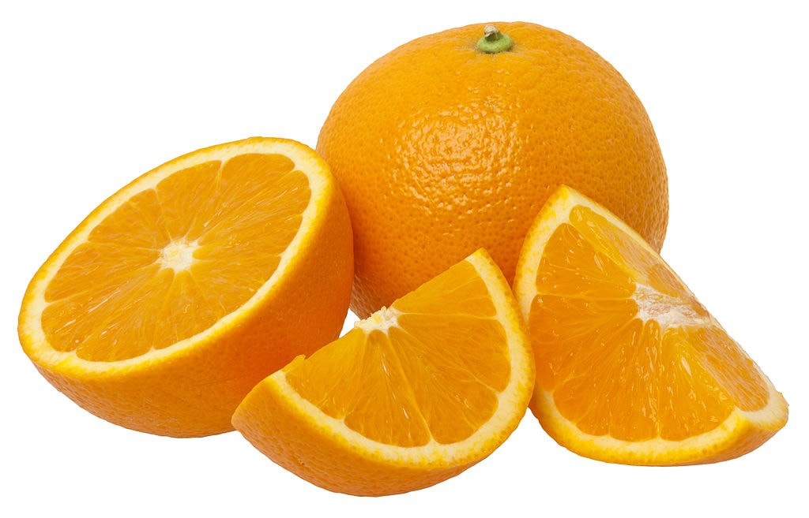
APPLE
ORANGE

Slide 32
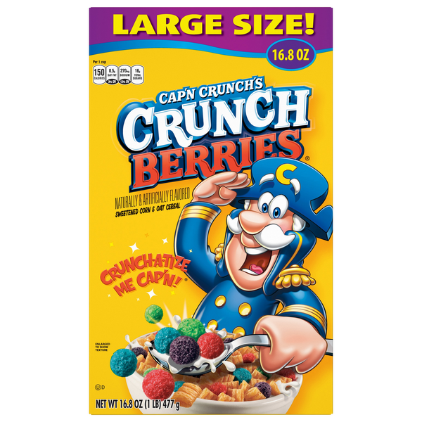

FRUITY PEBBLES
CAP’N CRUNCH

Slide 33
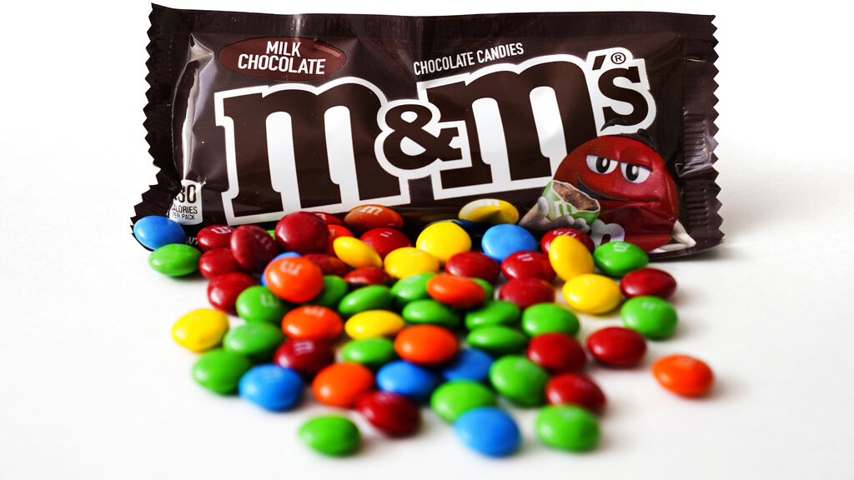
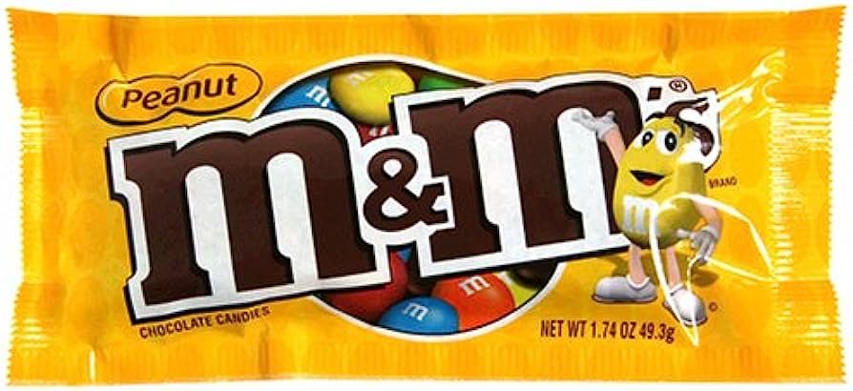
M&M’s

Slide 34
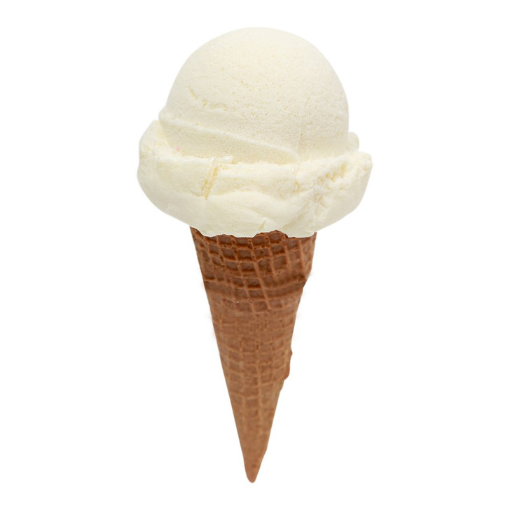
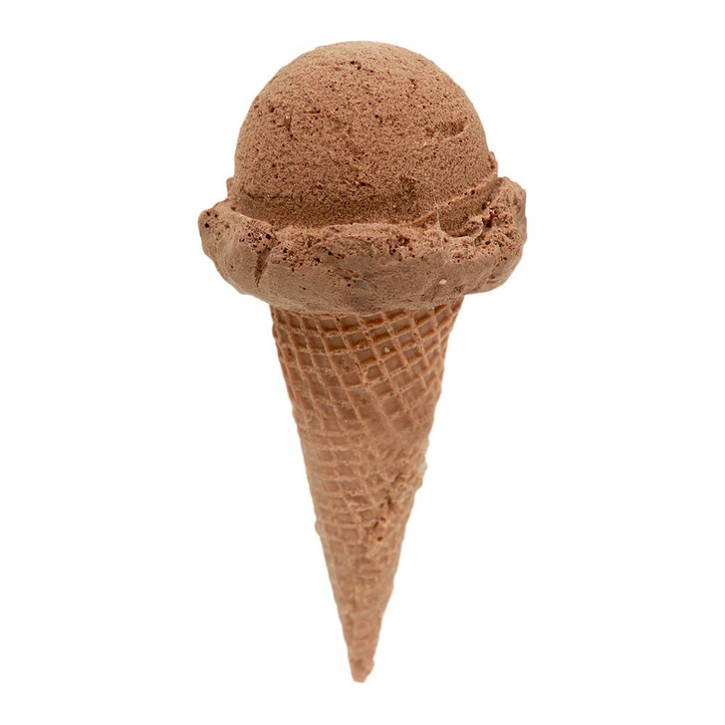
VANILLA
CHOCOLATE

Slide 35


COLD STONE
BRUSTERS

Slide 36
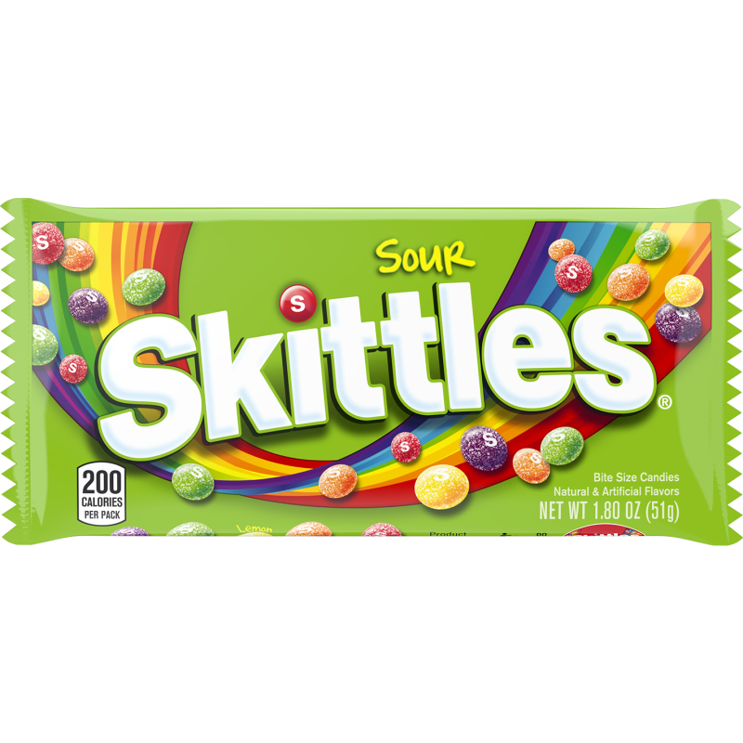
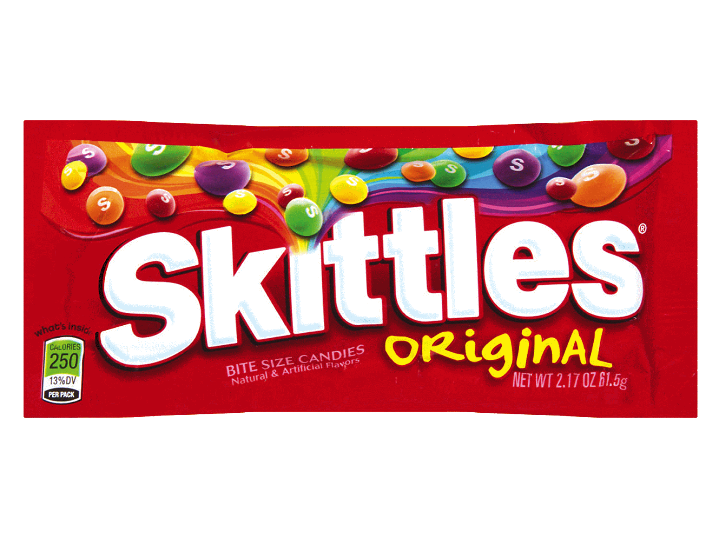
SOUR SKITTLES
REGULAR SKITTLES

Slide 37
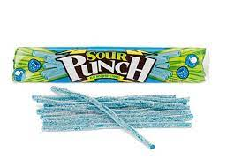
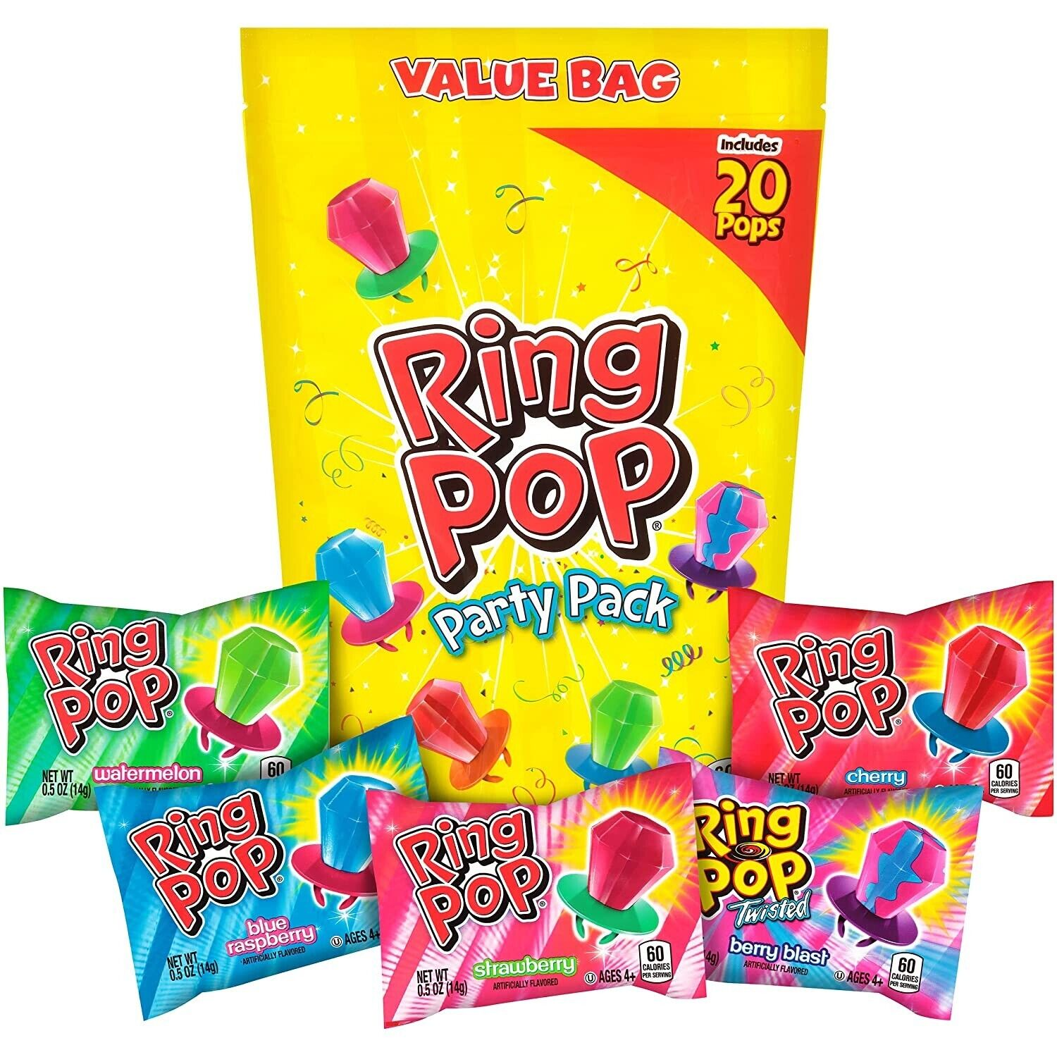
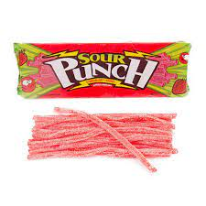
SOUR PUNCH STRAW
RING POP

Slide 38


BUTTER FINGER
REESE’S

Slide 39
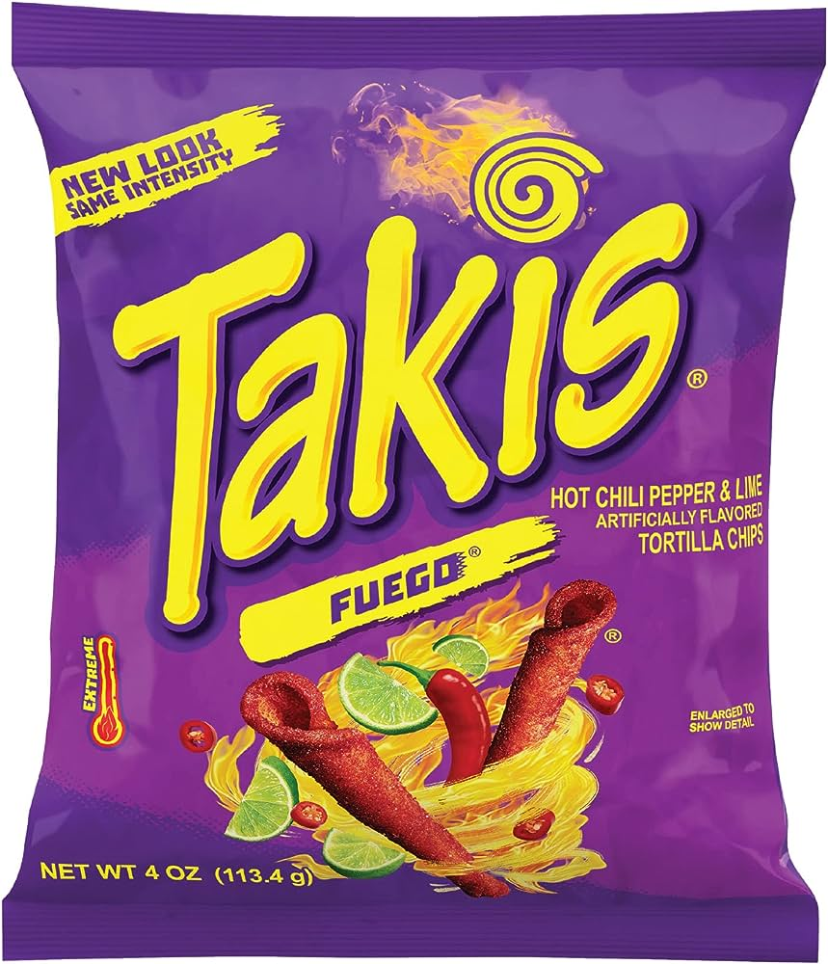
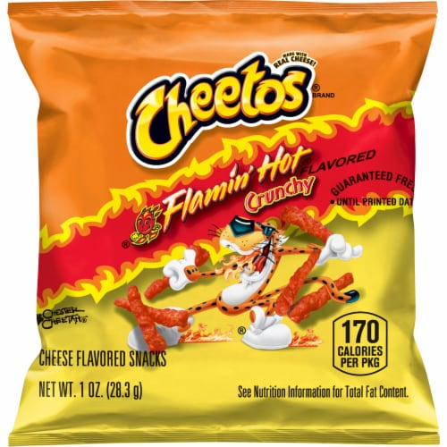
TAKIs
HOT CHEETOS

